Slide 1




Noida Institute of Engineering and Technology, Greater Noida
Arithmetic and logic unit
Unit: 2
Subject Name
Computer Organization and Architecture
AMIT YADAV
Assistant Professor Department: ECE
Course Details (B Tech 3rd Sem)

Slide 2
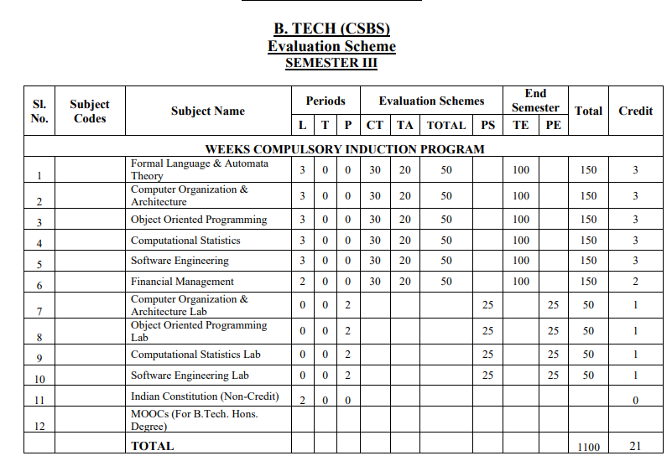
Evaluation Scheme

Slide 3
Course Objective
1. Discuss the basic concepts and structure of computers
Understand concepts of register transfer logic and arithmetic operation
Explain different types of control unit techniques and memory design
4. Learn the concepts of peripheral devices and their characteristics
5. Understand basics concepts of pipeline& parallel processor.
.

Slide 4
Course Outcome
S.NO | COURSE OUTCOME(CO) | CO –DESCRIPTION
1 | ACSBS0303.1 | Study of the basic structure and operation of a digital computer system.
2 | ACSBS0303.2 | Analysis of the design of arithmetic & logic unit and understanding of the fixed point and floating-point arithmetic operations.
3 | ACSBS0303.3 | Implementation of control unit techniques and memory design
4 | ACSBS0303.4 | Understand the concepts of peripheral devices and their characteristics
5 | ACSBS0303.5 | Understand the basics concepts of pipeline& parallel processor.

Slide 5
CO-PO and PSO Mapping
 |  | COMPUTER ORGANIZATION AND ARCHITECTURE
CO.K | PO1 | PO2 | PO3 | PO4 | PO5 | PO6 | PO7 | PO8 | PO9 | PO 10 | PO 11 | PO 12
ACSBS0303.1 | 3 | 2 | 1 | 1 | 1 | 1 | 1 | - | 1 | 1 | 1 | 2
ACSBS0303.2 | 2 | 2 | 2 | 2 | 1 | 1 | - | 1 | 1 | 1 | 1 | 2
ACSBS0303.3 | 3 | 2 | 2 | 1 | 2 | 2 | 1 | 1 | 2 | 2 | 1 | 2
ACSBS0303.4 | 3 | 2 | 2 | 2 | 2 | 1 | 1 | - | 1 | 1 | 1 | 2
ACSBS0303.5 | 2 | 2 | 2 | 1 | 2 | - | 1 | - | 1 | 2 | 2 | 2
Average | 2.6 | 2 | 1.8 | 1.4 | 1.6 | 1 | 0.8 | 0.4 | 1.2 | 1.4 | 1.2 | 2

Slide 6
CO-PO and PSO Mapping
 |  |  |  | COMPUTER ORGANIZATION AND ARCHITECTURE (KCS-302)
CO.K | PO1 | PO2 | PO3 | PO4 | PO5 | PO6 | PO7 | PO8 | PO9 | PO10 | PO11 | PO12
ACSBS0303.1 | 3 | 2 | 1 | 1 | 1 | 1 | 1 | - | 1 | 1 | 1 | 2
ACSBS0303.2 | 2 | 2 | 2 | 2 | 1 | 1 | - | 1 | 1 | 1 | 1 | 2
ACSBS0303.3 | 3 | 2 | 2 | 1 | 2 | 2 | 1 | 1 | 2 | 2 | 1 | 2
ACSBS0303.4 | 3 | 2 | 2 | 2 | 2 | 1 | 1 | - | 1 | 1 | 1 | 2
ACSBS0303.5 | 2 | 2 | 2 | 1 | 2 | - | 1 | - | 1 | 2 | 2 | 2
Average | 2.6 | 2 | 1.8 | 1.4 | 1.6 | 1 | 0.8 | 0.4 | 1.2 | 1.4 | 1.2 | 2
COMPUTER ORGANIZATION AND ARCHITECTURE (KCS-302)
CO.K | PSO1 | PSO2 | PSO3 | PSO4
ACSBS0303.1 | 3 | 3 | 3 | 2
ACSBS0303.2 | 2 | 2 | 2 | 1
ACSBS0303.3 | 3 | 3 | 3 | 2
ACSBS0303.4 | 2 | 3 | 3 | 2
ACSBS0303.5 | 2 | 3 | 3 | 1
Average | 2.4 | 2.8 | 2.8 | 1.6

Slide 7
Prerequisite and Recap
Basic knowledge of Computer Hardware
Basic knowledge of Digital Logic Design

Slide 8
Content
Look ahead carry adders
Signed operand multiplication
Booth algorithm and array multiplier
Division and logic operations
Floating point arithmetic operations
Arithmetic and logic unit design
IEEE standard for floating point numbers
*CISC (Topic Beyond Syllabus)

Slide 9
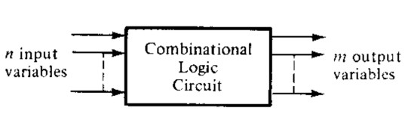
Combinational Logic Circuits
A combinational circuit consists of input variables (n), logic gates, and output variables (m).
For (n) input variables there are 2^{n} possible combinations of binary input values.
Each output function expressed in terms of the (n) input variables

Slide 10

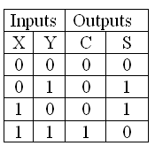
Half Adder
Half adder is a combinational arithmetic circuit that adds two numbers and produces a sum bit(S) and carry bit (C) as the ouput. If A and B are the input bits ,then sum bit(S) is the X-OR of A and B and the carry bit (C) will be the AND of A and B.
The block diagram of half adder is:
Truth Table for half adder is:

Slide 11
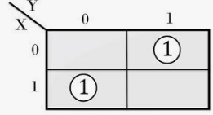
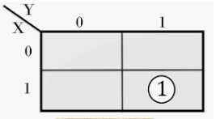

Half Adder
K-map of sum and carry for half adder:
From K-map boolean equations for sum and carry are:

Slide 12
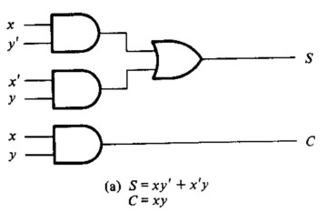
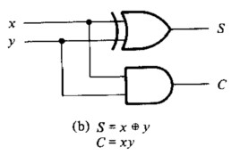
Half Adder
Logic diagram of half adder:

Slide 13
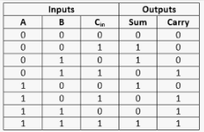
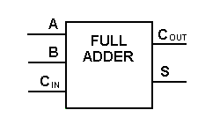
Full Adder
Full adder is developed to overcome the drawbacks of Half Adder circuit. It can add two one-bit numbers A and B, sum S and carry C.
The full adder is a three input and two output combinational circuit
Truth Table : Block Diagram:

Slide 14
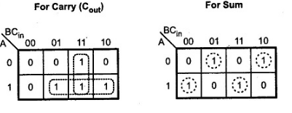
Full Adder
Logical Expression for SUM: = A’ B’ C_{in} + A’ B C_{in}’ + A B’ C_{in}’ + A B C_{in} = C_{in} (A’ B’ + A B) + C_{in}’ (A’ B + A B’) = C_{in} XOR (A XOR B)
= A XOR B XOR C_{in}
Logical Expression for Carry:
= AB + BC_{in} + C_{in} A

Slide 15
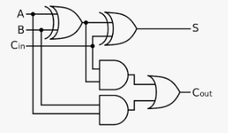
Full Adder
Circuit diagram of full adder
Sum = A XOR B XOR C_{in}
Carry = AB + BC_{in} + C_{in} A=AB + C_{in} (A xor B)

Slide 16
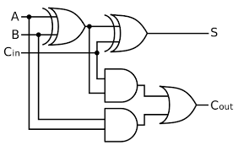
Full Adder
Full Adder using two half adders :
Sum = = A XOR B XOR C_{in}
Carry = AB + BC_{in} + C_{in} A
= A B + A C_{in} + B C_{in} (A + A’) = A B C_{in} + A B + A C_{in} + A’ B C_{in} = A B (1 + C_{in} ) + A C_{in} + A’ B C_{in} = A B + A C_{in} + A’ B C_{in} = A B + A C_{in} (B + B’) + A’ B C_{in} = A B C_{in} + A B + A B’ C_{in} + A’ B C_{in} = A B (C_{in} + 1) + A B’ C_{in} A’ B C_{in} = A B + A B’ C_{in} + A’ B C_{in} = AB + C_{in} (A’ B + A B’) = AB + C_{in} (A xor B)

Slide 17
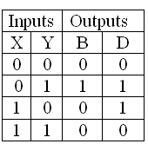
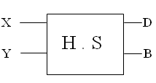

Half Subtractor
Half subtractor is an arithmetic circuit that subtracts two binary numbers from each other, for example, X – Y to find the resulting difference between the two numbers.
Half subtractor produces a difference (D) by using a borrow bit(B) from the previous column.
Block Diagram and Truth Table :

Slide 18
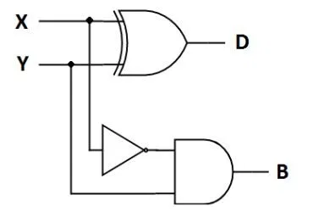
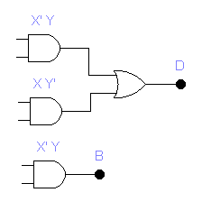
Logic Diagram of Half Subtractor :
Half Subtractor

Slide 19
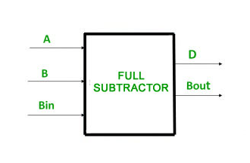
Full Subtractor
A full subtractor is a combinational circuit that performs subtraction of two bits, one is minuend and other is subtrahend, taking into account borrow of the previous adjacent lower minuend bit. This circuit has three inputs and two outputs. The three inputs A, B and Bin, denote the minuend, subtrahend, and previous borrow, respectively. The two outputs, D and Bout represent the difference and output borrow.

Slide 20
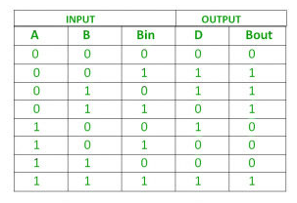
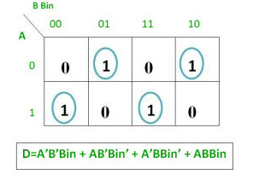
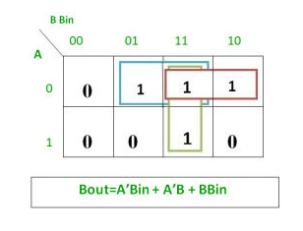
Truth Table of Full subtractor:
Full Subtractor
K-map for full subtractor:

Slide 21
Full Subtractor
Logical expression for difference –
D = A’B’Bin + A’BBin’ + AB’Bin’ + ABBin = Bin(A’B’ + AB) + Bin’(AB’ + A’B)
= Bin( A XNOR B) + Bin’(A XOR B) = Bin (A XOR B)’ + Bin’(A XOR B)
= Bin XOR (A XOR B) = (A XOR B) XOR Bin
Logical expression for borrow –
Bout = A’B’Bin + A’BBin’ + A’BBin + ABBin
= Bin(AB + A’B’) + A’B(Bin + Bin’) = Bin( A XNOR B) + A’B
= Bin (A XOR B)’ + A’B

Slide 22
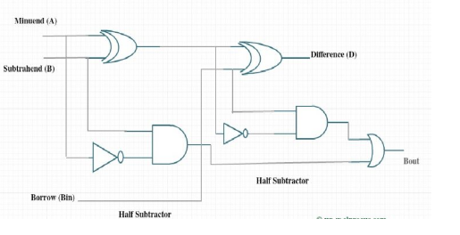
Full Subtractor
Full Subtractor using two half subtractor:
D = (A XOR B) XOR Bin & Bout = Bin (A XOR B)’ + A’B

Slide 23
carry look-ahead adder
This adder is used to eliminate the carry propagation delay problem in binary adder .
In binary adder ,each stage depends upon the carry generated by previous stage.It creates lots of delays. When we want to add two large binary no.
One widely used approach employs the principle of carry look-ahead solves this problem by calculating the carry signals in advance, based on the input signals.
This type of adder circuit is called as carry look-ahead adder (CLA adder). It is based on the fact that a carry signal will be generated in two cases:
when both bits A_{i} and B_{i} are 1, or
when one of the two bits is 1 and the carry-in (carry of the previous stage) is 1.

Slide 24
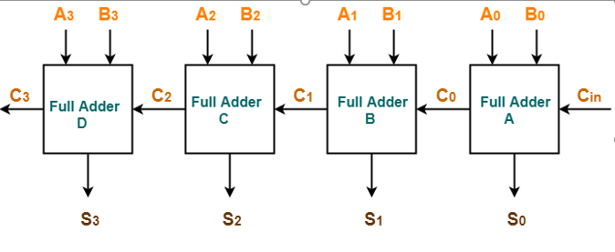
Look ahead carry adders

Slide 25
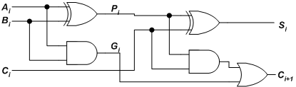
Look ahead carry adders
The Figure shows the full adder circuit used to add the operand bits in the i^{th} column; namely A_{i} & B_{i} and the carry bit coming from the previous column (C_{i} ).

Slide 26
Look ahead carry adders
G_{i} is known as the carry Generate signal since a carry (C_{i+1}) is generated whenever G_{i} =1, regardless of the input carry (C_{i}).
In this circuit, the 2 internal signals P_{i} and G_{i} are given by:
Pi = Ai ⊕ Bi ………………………(1)
G_{i}
= Ai Bi ……………….……..(2)
The output sum and carry can be defined as :
Si = Pi ⊕ Ci ……………………(3)
^{C}i +1 ^{= G}i
+ Pi Ci ………….(4)

Slide 27
Look ahead carry adders
P_{i} is known as the carry propagate signal since whenever P_{i} =1, the input carry is propagated to the output carry, i.e., C_{i+1}. = C_{i} (note that whenever P_{i} =1, G_{i} =0).
Computing the values of P_{i} and G_{i} only depend on the input operand bits (A_{i} & B_{i}) as clear from the Figure and equations.
Thus, these signals settle to their steady-state value after the propagation through their respective gates.
Computed values of all the P_{i}’s are valid one XOR-gate delay after the operands A and B are made valid.
Computed values of all the G_{i}’s are valid one AND-gate delay after the operands A and B are made valid.

Slide 28
Look ahead carry adders
The Boolean expression of the carry outputs of various stages can be written as follows:
C₁ = G₀ + P₀C₀
C₂ = G₁ + P₁C₁ = G₁ + P₁ (G₀ + P₀C₀)
= G₁ + P₁G₀ + P₁P₀C₀
C₃ = G₂ + P₂C₂ = G₂ + P₂G₁ + P₂P₁G₀ + P₂P₁P₀C₀ C₄ = G₃ + P₃C₃
= G₃ + P₃G₂ + P₃P₂G₁ + P₃P₂P₁G₀ + P₃P₂P₁P₀C₀
In general, the i^{th.} carry output is expressed in the form C_{i} = F_{i} (P’s, G’s , C₀).
In other words, each carry signal is expressed as a direct SOP function of C₀ rather than its preceding carry signal.
Since the Boolean expression for each output carry is expressed in SOP form, it can be implemented in two-level circuits.
The 2-level implementation of the carry signals has a propagation delay of 2 gates.

Slide 29
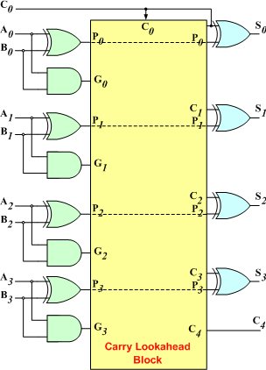
Look ahead carry adders
The 4-bit carry look-ahead (CLA) adder consists of 3 levels of logic:

Slide 30
Look ahead carry adders
First level: Generates all the P & G signals. Four sets of P & G logic (each consists of an XOR gate and an AND gate). Output signals of this level (P’s & G’s) will be valid after 1τ.
Second level: The Carry Look-Ahead (CLA) logic block which consists of four 2-level implementation logic circuits. It generates the carry signals (C₁, C₂, C₃, and C₄) as defined by the above expressions. Output signals of this level (C₁, C₂, C₃, and C₄) will be valid after 3τ.
Third level: Four XOR gates which generate the sum signals (S_{i}) (S_{i} = P_{i} ⊕ C_{i}). Output signals of this level (S₀, S₁, S₂, and S₃) will be valid after 4τ.
Thus, the 4 Sum signals (S₀, S₁, S₂ & S₃) will all be valid after a total delay of 4τ compared to a delay of (2n+1)τ for Ripple Carry adders.
For a 4-bit adder (n = 4), the Ripple Carry adder delay is 9τ.

Slide 31
Look ahead carry adders
The disadvantage of the CLA adders is that the carry expressions (and hence logic) become quite complex for more than 4 bits.
Thus, CLA adders are usually implemented as 4-bit modules that are used to build larger size adders.

Slide 32
Look ahead carry adders
Binary Multiplier
Multiplication of binary numbers is performed in the same way as with decimal numbers.
The multiplicand is multiplied by each bit of the multiplier, starting from the least significant bit.
The result of each such multiplication forms a partial product. Successive partial products are shifted one bit to the left.
The product is obtained by adding these shifted partial products.

Slide 33
Multiplier
A basic multiplier can consist of three parts:
• Partial product generation
• Partial product addition and
• Final addition
Several types of multipliers are studied: array multipliers, wallace tree multipliers, booth multiplier.

Slide 34
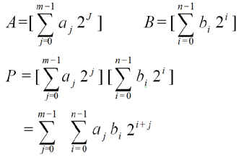
Basic Multiplication Operation
The most basic form of multiplication consists of forming the product of two binary numbers m and n.
A and B be the operands with m and n bits respectively

Slide 35
Methods
There are number of techniques that can be used to perform multiplication.
Array Multiplier, Booth Multiplier and Wallace Tree Multipliers are some of the standard approaches to have hardware implementation of binary Multiplier which are suitable for VLSI implementation at CMOS level.

Slide 36
Array Multiplier
Array multiplier is common in multiplier design due to its regular and compact structure.
The structure of array multiplier is organized by several stages of adders and AND-gates.
It generates all the partial products after only one AND-gate delay. Then, it sums up all partial products sequentially.

Slide 37
Principles of Array Multiplier
4*4 bit multiplication
 |  |  |  | a₃ | a₂ | a₁ | a₀
 |  |  | × | b₃ | b₂ | b₁ | b₀
 |  |  |  | a₃b₀ | a₂b₀ | a₁b₀ | a₀b₀
 |  |  | a₃b₁ | a₂b₁ | a₁b₁ | a₀b1
 |  | a₃b₂ | a₂b₂ | a₁b₂ | a₀b₂
 | a₃b₃ | a₃b₂ | a₃b₁ | a₃b₀
p₇ | p₆ | p₅ | p₄ | p₃ | p₂ | p₁ | p₀

Slide 38
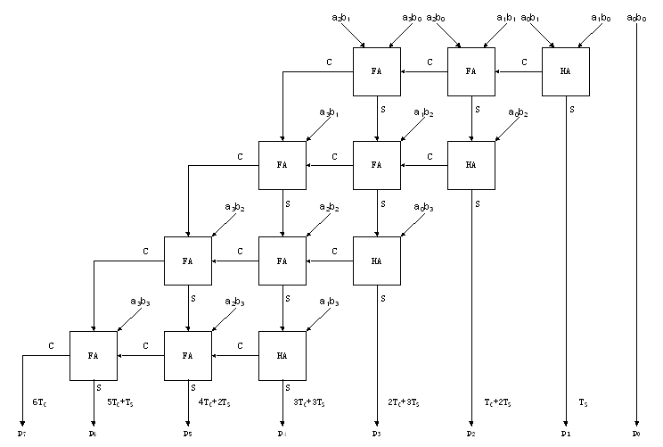
For 4*4 Array Multiplier, it needs 16 AND gates, 4 HAs, 8FAs (total 12 Adders)
For m*n Array Multiplier, it needs m*n AND gates, n HAs, (m-2)*n FAs, (total (m-1)*n Adders)

Slide 39
Principles of Array Multiplier(Cont.)

Slide 40
Faculty Video Links, Youtube Courses Details
Youtube/other Video Links
https://www.youtube.com/watch?v=vcvgvqnH7GA
https://www.youtube.com/watch?v=U62iP8RkZIk
https://www.youtube.com/watch?v=6ToR6vuRb3M
https://www.youtube.com/watch?v=9nkCLdhLDZk
https://www.youtube.com/watch?v=0HiGruw9VcQ

Slide 41
Daily Quiz
Which method/s of representation of numbers occupies a large amount of memory than others? a) Sign-magnitude b) 1’s complement c) 2’s complement d) 1’s & 2’s compliment Answer: a
When we perform subtraction on -7 and 1 the answer in 2’s complement form is _________ a) 1010 b) 1110 c) 0110 d) 1000 Answer: d
The register used to store the flags is called as _________ a) Flag register b) Status register c) Test register d) Log register View Answer
Answer: b

Slide 42
Daily Quiz
For the addition of large integers, most of the systems make use of ______ a) Fast adders b) Full adders c) Carry look-ahead adders d) None of the mentioned Answer: c
When 1101 is used to divide 100010010 the remainder is ______ a) 101 b) 11 c) 0 d) 1 Answer: d

Slide 43
Weekly Assignment
List and explain different types of shift micro-operation .
Show the contents of registers E, A, Q and SC during the process of division 00001111 by 0011.
3. Show the hardware diagram & flow chart of Booth algorithm for multiplying two numbers.
4. Discuss various methods to design hardwired control unit.
5. Define IEEE 754 standard for floating point representation with suitable example.
a) (23.175)₁₀
b) (0.6128)₁₀
c) (1000.010101)₂

Slide 44
MCQ
1. Which method/s of representation of numbers occupies a large amount of memory than others? a) Sign-magnitude b) 1’s complement c) 2’s complement d) 1’s & 2’s compliment Answer: a
2. Which representation is most efficient to perform arithmetic operations on the numbers? a) Sign-magnitude
b) 1’s complement c) 2’S complement d) None of the mentioned Answer: c
3. Which method of representation has two representations for ‘0’? a) Sign-magnitude b) 1’s complement c) 2’s complement d) None of the mentioned Answer: a

Slide 45
MCQ
4. When we perform subtraction on -7 and 1 the answer in 2’s complement form is _________ a) 1010 b) 1110 c) 0110 d) 1000 Answer: d
5. When we perform subtraction on -7 and -5 the answer in 2’s complement form is ________ a) 11110 b) 1110 c) 1010 d) 0010 Answer: b
6. When we subtract -3 from 2 , the answer in 2’s complement form is _________ a) 0001 b) 1101 c) 0101 d) 1001 Answer: c

Slide 46
MCQ
7. The processor keeps track of the results of its operations using flags called ________ a) Conditional code flags b) Test output flags c) Type flags d) None of the mentioned Answer: a
8. The register used to store the flags is called as _________ a) Flag register b) Status register c) Test register d) Log register Answer: b
9. The Flag ‘V’ is set to 1 indicates that _____________ a) The operation is valid b) The operation is validated c) The operation has resulted in an overflow d) None of the mentioned Answer: c

Slide 47
MCQ
10. In some pipelined systems, a different instruction is used to add to numbers which can affect the flags upon execution. That instruction is _______ a) AddSetCC b) AddCC c) Add++ d) SumSetCC Answer: a
11. The most efficient method followed by computers to multiply two unsigned numbers is _______ a) Booth algorithm b) Bit pair recording of multipliers c) Restoring algorithm d) Non restoring algorithm Answer: b
12. For the addition of large integers, most of the systems make use of ______ a) Fast adders b) Full adders c) Carry look-ahead adders d) None of the mentioned Answer: c

Slide 48
MCQ
13. In a normal n-bit adder, to find out if an overflow as occurred we make use of ________ a) And gate b) Nand gate c) Nor gate d) Xor gate Answer: d
14. In the implementation of a Multiplier circuit in the system we make use of _______ a) Counter b) Flip flop c) Shift register d) Push down stack Answer: c
15. When 1101 is used to divide 100010010 the remainder is ______ a) 101 b) 11 c) 0 d) 1 Answer: d

Slide 49
MCQ
16. The two phases of executing an instruction are __________ a) Instruction decoding and storage b) Instruction fetch and instruction execution c) Instruction execution and storage d) Instruction fetch and Instruction processing Answer: b
17. The Instruction fetch phase ends with _________ a) Placing the data from the address in MAR into MDR b) Placing the address of the data into MAR c) Completing the execution of the data and placing its storage address into MAR d) Decoding the data in MDR and placing it in IR Answer: d
18. The instruction, Add R1,R2,R3 in RTN is _______ a) R3=R1+R2+R3 b) R3<-[R1]+[R2]+[R3] c) R3=[R1]+[R2] d) R3<-[R1]+[R2] Answer: d

Slide 50
MCQ
19. In micro-programmed approach, the signals are generated by ______ a) Machine instructions b) System programs c) Utility tools d) None of the mentioned Answer: a
20. A word whose individual bits represent a control signal is ______ a) Command word b) Control word c) Co-ordination word d) Generation word Answer: b
21. A sequence of control words corresponding to a control sequence is called _______ a) Micro routine b) Micro function c) Micro procedure d) None of the mentioned Answer: a

Slide 51
MCQ
22. To read the control words sequentially _________ is used. a) PC b) IR c) UPC d) None of the mentioned Answer: c
23. Every time a new instruction is loaded into IR the output of ________ is loaded into UPC. a) Starting address generator b) Loader c) Linker d) Clock Answer: a
24. The case/s where micro-programmed can perform well _______________ a) When it requires to check the condition codes b) When it has to choose between the two alternatives c) When it is triggered by an interrupt d) None of the mentioned Answer: d
25. The signals are grouped such that mutually exclusive signals are put together. a) True b) False Answer: a

Slide 52
Old Question Papers

Slide 53
Expected Questions for University Exam
Draw the flow chart for multiplying algorithm of sign magnitude data.
Show the contents of registers E, A, Q & SC during the process of division of 10100011 by 1011
Explain the IEEE 754 for floating point no. with examples
Show the flow diagram & multiplication process using Booth’s Algorithm for (-4) X (+3)
Write a short note on CISC. Also explain its characteristics.
Write down the difference between CISC and RISC.
Differentiate between Horizontal & Vertical microprogramming.
Design a four bit adder-subtractor with complete block diagram.
Design an array multiplier that multiplies two 4-bit numbers. Use AND gate and binary adder.
Explain Booth’s algorithm for multiplying binary integer in signed 2’s complement representation.

Slide 54
Summary
In previous slides we discussed in details about:
Carry look ahead adder
Signed operand multiplication
Booths algorithm and array multiplier
Division and logic operations
Floating point arithmetic operation
Arithmetic & logic unit design
IEEE standard for floating point numbers

Slide 55

References
Computer System Architecture, Morris Mano, PHI.
Cavanagh, J.J.F., Digital computer arithmetic. New York : McGraw-Hill, 1984.
https://www.youtube.com/watch?v=vcvgvqnH7GA
https://www.youtube.com/watch?v=U62iP8RkZIk
https://www.youtube.com/watch?v=6ToR6vuRb3M
https://www.youtube.com/watch?v=9nkCLdhLDZk
https://www.youtube.com/watch?v=0HiGruw9VcQ

